Slide 1
IIT MADRAS BUSINESS DATA MANAGEMENT CAPSTONE PROJECT
CASE STUDY OF PRADEEP MAAN TRADING COMPANY
BY- LAKSHIKA SHEORAN
22f2001175
22f2001175@ds.study.iitm.ac.in

Slide 2
INTRODUCTION TO BUSINESS
The business from where I collected data is a medium-sized B2C shop, started by “Mr. Pradeep Maan” in 2023.
The business deals primarily in fertilizers, pesticides, urea and many more.
Unfortunately, the shop has been facing challenges in terms of Profit, Sales & Inventory Management

Slide 3
DATA COLLECTION AND CLEANING
Collected data from their records which they kept in software of laptop.
Extracted data for 10 products from a long list of products.
The collected data for analysis was “Primary data”, mostly in an formal way, as it was from an organized business.
To clean the data, I used an Excel spreadsheet. Additionally, I used Excel for all my data analysis

Slide 4
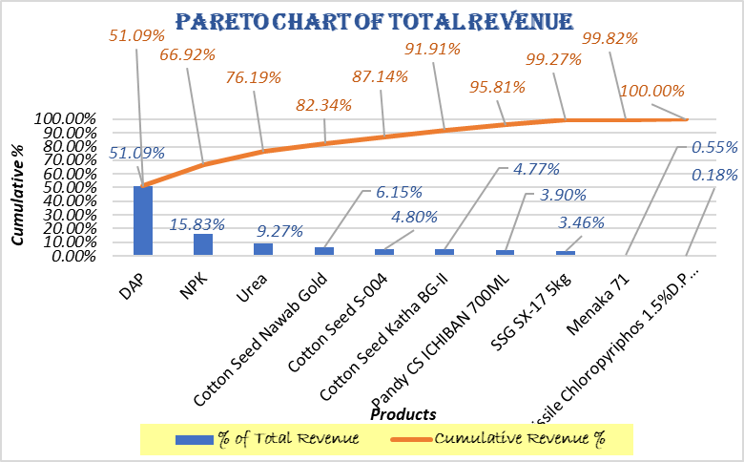

DATA ANALYSIS OF SALES
.
DAP, NPK, Urea are the most revenue generating.
Average Daily Revenue | ₹ 28,399.86
Std. Deviation | 12,781.28
Min Revenue | ₹5,136.50
Max Revenue | ₹68,822.00
Range | ₹63,685.50
DAP, NPK, Urea contribute to 80% of total revenue.

Slide 5
DATA ANALYSIS ON PURCHASE
Products such as DAP, NPK, Urea and Missile Chlorpyriphos 15%D.P.100Gm seem to maintain consistent purchase prices throughout the entire period.
Products such as SSG SX-17 5KG and Pandy CS ICHIBAN 700ML are in lower price range indicating that these products have the least fluctuation and remain affordable.
There are distinct product grouping based on price. Cotton Seeds are consistently more expensive than fertilisers like DAP and NPK.

Slide 6

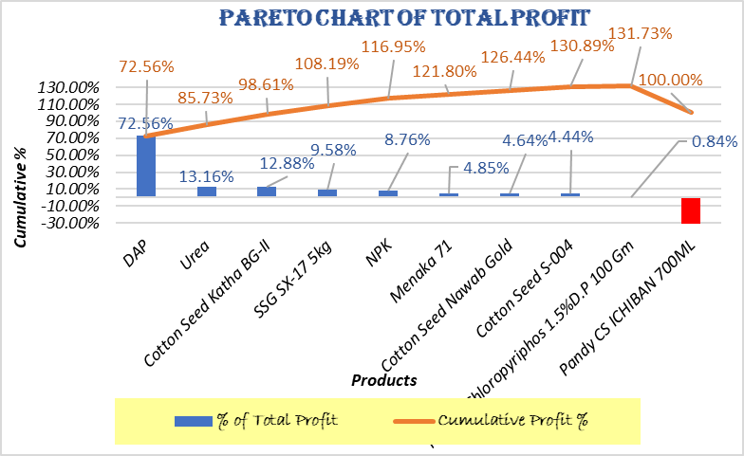
DATA ANALYSIS ON PROFIT/LOSS
DAP contribute to 80% approx. to total profit.
The above analysis shows that DAP, NPK, Urea are key products for generating both revenue and profit.

Slide 7
DATA ANALYSIS ON INVENTORY
DAP, NPK, Urea have stock levels significantly higher than their average sales, indicating potential overstocking.
This Graph demonstrates huge inventory fluctuations resulting in overstocking

Slide 8
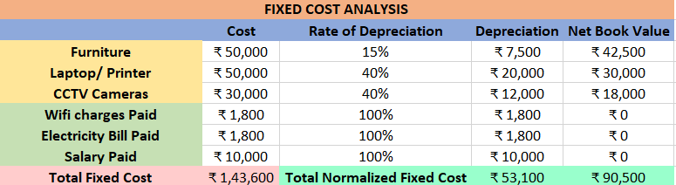
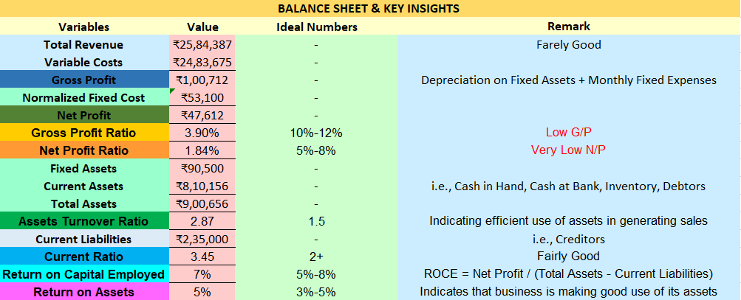
FINDINGS – Profit/Loss & INSIGHTS

Slide 9
SOLUTIONS/RECOMMENDATIONS
Increase sales of High-Profit items (e.g. Cotton Seed Katha BG-II)
Enhance shop display and visual Merchandising
Implement Effective Pricing Strategies
Solutions to tackle with the business challenges
Adjust Inventory Re-order Level Before High Sales Periods
Optimize financial health
Optimize Inventory Levels (e.g. DAP, NPK, Urea)

Slide 10
THANK YOU!

